Slide 1
Module: Machine Learning and Data-Driven Materials
Machine Learning – Uncertainty Estimation
Institute for Materials Discovery (IMD)
University College London (UCL)
Dr. Zied Hosni, Dr. Miguel Rodriguez Pineda, Prof. Adham Hashibon
Email: ucqshos@ucl.ac.uk
|
|

Slide 2
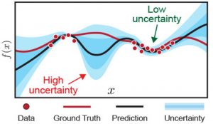
Introduction to Uncertainty estimation
Uncertainty in machine learning refers to the lack of confidence or trust that a model has in its predictions.
It arises due to the fact that machine learning models are trained on a limited amount of data, and this data may not perfectly represent the true distribution of the problem that the model is trying to solve.
As a result, there may be some level of uncertainty in the model's predictions.

Slide 3
Sources of uncertainty in machine learning
Model uncertainty: This refers to uncertainty in the model's parameters, architecture, or assumptions. Models with high model uncertainty are those that have not been well-validated or have a high degree of complexity.
Data uncertainty: This refers to uncertainty in the data used to train the model. The data may be noisy, incomplete, or biased, which can lead to uncertainty in the model's predictions.
Prediction uncertainty: This refers to uncertainty in the model's predictions for a particular input. It can arise when the model is uncertain about the correct class label or when it is uncertain about the quality of its prediction.

Slide 4
In material discovery, uncertainty estimation can help us to determine the reliability and accuracy of the predicted properties of materials, which is critical for the development of new materials with specific properties.
For example, in the field of materials science, we may want to predict the properties of a new material based on its chemical composition and crystal structure.

Slide 5
In addition, uncertainty estimation can help us to identify potential errors or biases in the data or the model, which can be critical in real-world applications.
For example, if the uncertainty estimation reveals that the model is uncertain in certain regions of the input space, this can indicate that there are gaps in the data or that the model is not well-suited to the problem at hand. This can help us to identify areas where further research or data collection may be needed.

Slide 6
Epistemic uncertainty
Epistemic uncertainty refers to uncertainty arising from a lack of knowledge or information.
It is also known as model uncertainty or parameter uncertainty, and it is inherent in the model itself.
Epistemic uncertainty arises due to factors such as limited data, model bias, or model complexity.
Epistemic uncertainty can be reduced through better model selection, parameter tuning, or by collecting more data.

Slide 7
Aleatoric uncertainty
The uncertainty arising from the inherent randomness or variability in the data.
It is also known as data uncertainty, and it is independent of the model itself.
Aleatoric uncertainty can arise due to factors such as measurement noise, natural variability, or incomplete data.
Aleatoric uncertainty cannot be reduced through model selection or parameter tuning and can only be reduced by collecting more or better data.

Slide 8
Example of epistemic and aleatoric uncertainty
Consider the example of a model that is trained to predict the temperature in a room based on the outside temperature, the time of day, and the number of people in the room.
Epistemic uncertainty could arise from factors such as the choice of model architecture or the values of the model parameters, which can be reduced through better model selection and parameter tuning. | Aleatoric uncertainty could arise from factors such as measurement noise or natural variability in the temperature, which cannot be reduced through model selection or parameter tuning and can only be reduced by collecting more or better data.

Slide 9
Conformal prediction
Conformal prediction is a method that provides a measure of confidence for individual predictions, which can be especially useful in situations where false positives or false negatives can be costly.
Conformal prediction has been successfully applied in various applications, including material discovery, where it has been used to predict the thermodynamic stability of compounds.
One limitation of conformal prediction is that it can be computationally expensive, especially when dealing with large datasets.

Slide 10
Unlike conventional machine learning techniques, conformal prediction is based on the principles of statistical inference, which allows for quantifying the uncertainty associated with the predictions.
This approach is particularly useful when the prediction accuracy is of paramount importance, and the cost of incorrect predictions is high.

Slide 11
(Conformal Prediction CP)
Dataset (X,y)
Training set
External test set (X_test,y_test)
Mean (y_cal)
Calibration set (X_cal,y_cal)
Proper training set (X_train,y_train)
Non-conformity scores nc_cal
Mean (y_cal.pred)
Prediction (y_cal.pred)
Build a model (RF, SVM)
Prediction (y_test.pred)
Rank scores nc_cal
Find the rank index C= ceil(nc)*(1-sgn.level)
Compute q =nc[c]
Compute bottom interval =
Y_test.pred - q
Compute bottom interval =
Y_test.pred + q
Measure error rates
=cases with y_test inside intervals/total cases
y_test
Confidence interval
Significance level M=100
Measure efficiency
= mean of intervals

Slide 12
Conformal prediction is a non-parametric approach, which means that it does not make any assumptions about the underlying distribution of the data.
It builds a set of non-conformity measures that capture the degree of similarity between the input data and the training data.
These measures are then used to construct a prediction interval that includes the true output value with a given level of confidence.

Slide 13
Performance of Conformal Prediction
Conformal prediction has been shown to outperform conventional machine learning techniques in several applications, including medical diagnosis, drug discovery, and credit risk assessment.
Its ability to provide reliable prediction intervals with a known level of confidence makes it particularly useful in safety-critical applications where the cost of incorrect predictions is high.

Slide 14
Binary classification problems using conformal prediction
Training:
Ranking:
Construction of Prediction Sets:
Validity Assessment:
Prediction:
Given a set of labelled training data, a conformity measure is trained on the data. The conformity measure should assign a p-value to each new sample, which represents the degree of conformity between the new sample and the training data.
For a new sample, the non-conformity measure is used to rank the potential outcomes or predictions for the sample. The non-conformity measure is a function that measures the degree of non-conformity between a new sample and the training data.
Based on the ranked predictions, a prediction set is constructed using a validity measure. The validity measure is a function that measures the error rate of the conformal predictor.
The validity index is calculated as the proportion of times the prediction sets contain the correct outcome over a set of validation samples. The validity index is used to assess the reliability of the prediction sets.
Once the prediction sets have been constructed and validated, a new sample is classified by examining whether its true label falls within the prediction set.

Slide 15
Steps to build the conformal prediction model
Conformal prediction is a machine learning technique that can be used for regression problems to provide prediction intervals that quantify the uncertainty of the prediction. Here are the steps involved in using conformal prediction for regression:
Data preparation: The first step is to prepare the data by splitting it into training and test sets. The training set is used to train the regression model, while the test set is used to evaluate the performance of the model and to construct the prediction intervals.

Slide 16
Strengths of conformal prediction for classification
Confidence and reliability: Conformal prediction provides a measure of the confidence and reliability of the predictions, which can be useful for decision-making in applications where the consequences of incorrect predictions are high.
Flexibility: Conformal prediction can be applied to a wide range of machine learning models and can be used with any type of data, including imbalanced datasets.
Customizability: The user can control the error rate and confidence level of the predictions independently, which provides flexibility in calibrating the predictions to the user's specific needs.
Robustness: Conformal prediction can be more robust to outliers and noise in the data compared to traditional prediction intervals, as it ranks the predictions based on a non-conformity measure rather than assuming a specific distribution of the data.

Slide 17
2. Model training:
The second step is to train the regression model on the training set. The choice of regression model depends on the specific application, but some popular choices include linear regression, decision trees, and support vector regression.

Slide 18
3. Non-conformity measure:
define a non-conformity measure that quantifies the deviation of a new data point from the training data.
The non-conformity measure is a function that maps a new data point to a scalar value that reflects how unusual the data point is relative to the training data.
One popular non-conformity measure is the absolute residual, which is the absolute difference between the predicted value and the true value.

Slide 19
4. P-value calculation:
calculate the p-value for each test data point, which is the probability of observing a non-conformity measure that is as large or larger than the non-conformity measure of the test data point, assuming that the null hypothesis is true.
The null hypothesis is that the test data point is consistent with the training data.

Slide 20
5. Significance level:
choose a significance level, which is the probability threshold for accepting or rejecting the null hypothesis.
The significance level is typically set to a small value, such as 0.05, to control the probability of making a false prediction.

Slide 21
6. Prediction interval:
construct the prediction interval for each test data point, which is a range of values that contains the true value of the target variable with a specified probability.
The prediction interval is constructed by including all the training data points whose non-conformity measure is smaller than the p-value of the test data point, and the width of the prediction interval is determined by the significance level and the number of training data points included in the interval.

Slide 22
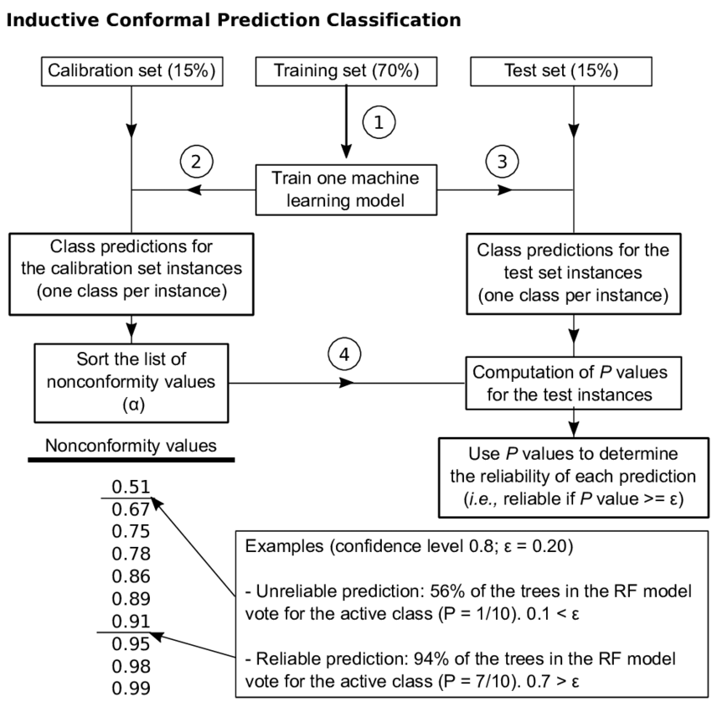

Slide 23
Practical

Slide 24
Run the notebooks about Conformal Prediction in Colab Python

Slide 25
PCA demonstration in Knime

